Slide 1


INTERNET OF THINGS & BIG DATA
THE PERFECT MARRIAGE

Slide 2

THE PERFECT MARRIAGE
Introduction - Internet of Things and its Business Opportunities
Making Sense of Data
Encourage Adoption and Innovation of IoT
IOT and Big Data Marriage Challenges
Latest trends and Developments

Slide 3

How Big is the IOT Market?
Copyright © RIOT 2015 All Rights Reserved

Slide 4
SIZE of market – African continent
IDC Research shows the 2016 IOT market in Africa was US$837.9 million with Estimated Annual Growth of 17% to US$1.8 billion in 2020
Contrast Globally 8.4 Billion Connected Devices estimated Growth to 20.5 Billion 2020 (Gartner)
Gartner predicts mainstream adoption in Africa by 2020
Social Needs Driving Current Adoption with Connectivity Providing the biggest Challenge

Slide 5
Existing use cases in africa
Smart Africa Alliance 11 countries spearheaded by Rwanda established 2013
Safety and IP cameras in Johannesburg, Pretoria and Cape Town reducing Crime
Smart Meters Managing electricity consumption
Drones for Endangered Species Protection
IBM has Established Research Labs in 2 Countries to Identify Opportunities
Microsoft and IBM have opened Cloud Data Centres in South Africa
Urban Areas have already Shadowed Global Developments with Uber, Google Maps, Wearables for Health/Fitness Monitoring
Next Frontier is Social Needs

Slide 6
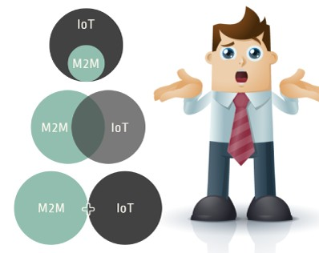
THE CURRENT ERA OF IOT
HOW IS IT DIFFERENT FROM M2M?

Slide 7
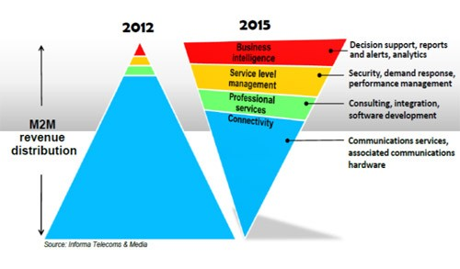
CHANGE IN BUSINESS MODEL

Slide 8
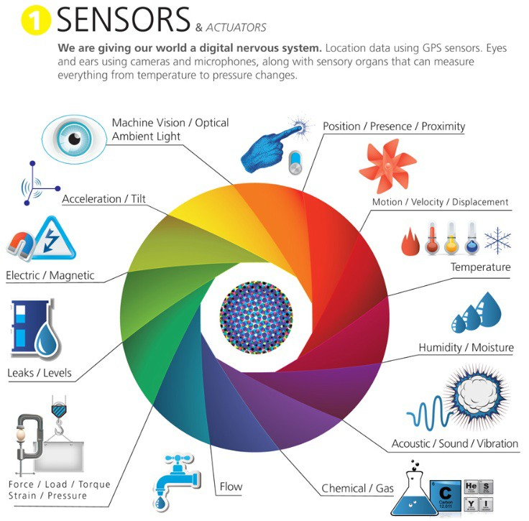
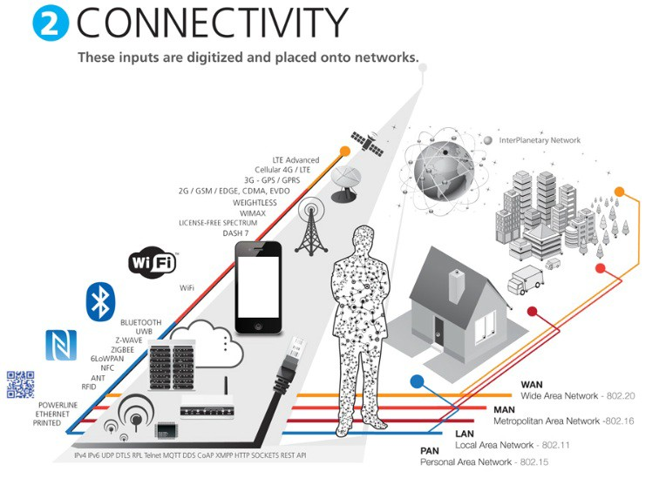
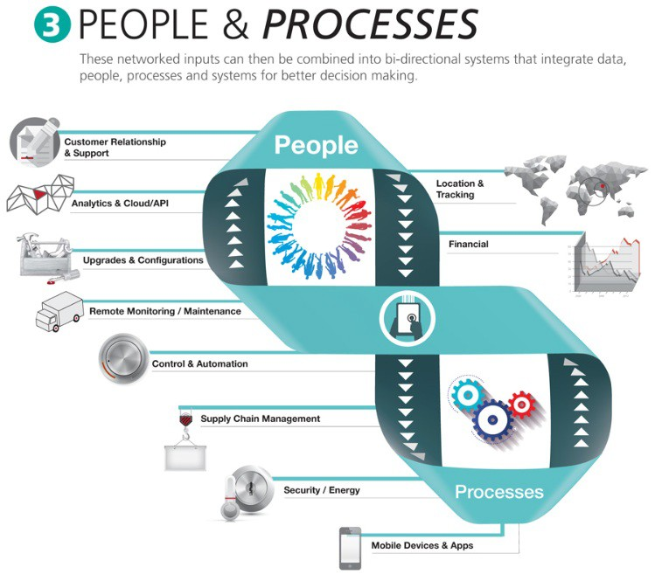
[Source:
http://postscapes.com/what-exactly-is- the-internet-of-things-infographic ]

Slide 9




















10/90 RULE
The Last 100 meter connectivity
Connected World
Still Disconnected
The “last 100 meters” represent > 90% potential number of connections
Today, the devices used in the “last 100 meters” are typically not connected. The wide-area network is to a larger extent connected e.g. through smartphones, home routers (e.g. ADSL routers) and GSM / 3G / 4G Routers.

Slide 10
BRING IOT TO THE NEXT LEVEL
FUTURE OF COMMUNICATIONS AND PRODUCTIVITY

Slide 11

















BUSINESS OPPORTUNITIES
Capabilities
Benefits
Improved Performance
Monitor
Control
Reduced Costs
Create Innovative Products
New Revenue Streams
Optimize
Autonomous

Slide 12








WHAT ARE THE BUSINESS CHALLENGES
Fragmented industry
Security and Privacy of data
Managing vast amounts of data
Finding the right business model
Copyright © RIOT 2015 All Rights Reserved

Slide 13
4 REASONS
WHY TELCOS HAVE DIFFICULTY TO EMBRACE IOT
Copyright © RIOT 2015 All Rights Reserved

Slide 14
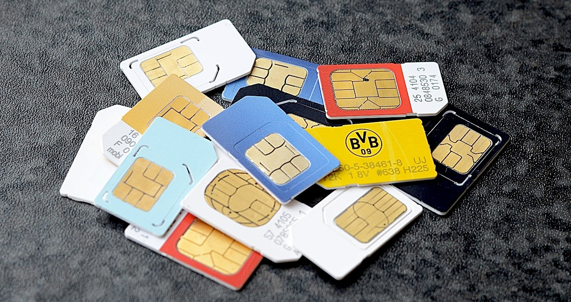










LEGACY BUSINESS IS STILL CONNECTIVITY
SIM-CARD BASED
OLD HABITS DIE HARD
LESS COMPLEX
M2M HIGH VOLUME
LOW ARPU
Copyright © RIOT 2015 All Rights Reserved

Slide 15






LACK OF DOMAIN EXPERTISE
THINK BEYOND CONNECTIVITY
SOLUTIONS, SELLING
AND MANAGED SERVICES
NEED GO-TO-MARKET PARTNER
Copyright © RIOT 2015 All Rights Reserved

Slide 16








MINDSET BLOCK
FULL OF SKEPTISM
LOW SINGLE DIGIT GROWTH CONTRIBUTION
Copyright © RIOT 2015 All Rights Reserved

Slide 17











STABLE BUSINESS VS. RISKY VENTURES
IOT BUSINESS IS FLUID
NEED TO WORK LIKE STARTUP
Copyright © RIOT 2015 All Rights Reserved

Slide 18
THE END GAME
END-TO-END IOT SERVICE PROVIDER

Slide 19


























END-TO-END IOT SERVICE PROVIDER
s m a r t c i t y
Network
Platform
smart transport
s m a r t a u t o m o t i v e
Device Provider
Network Provider
Platform Provider
Application Provider
Customer

Slide 20



























































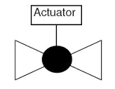


IoT Logical Architecture – Open Source
Big Data / BI
Storage
St
orage
IoT Services
Stream
ing
IoT Device
IoT Gateway
A
nalytics
Event
Storage
a Analytics
ics
UI
Stre
ming
Hub
Event
Bulk Analyt
S
ensor
Sto
Hub
App
UI
rage
BPM and SOA
Platform
Services Processes
Actuator
Stor
age
Streaming
Service Bus
Ana
lyti
cs
Event
BLE
ZigBee WIFI
Wired
Hub
Service Bus
Service
API
MQTT CoAP XMPP DDS AMQP KAFKA WIFI
Bus
Enterprise Applications
UI
Endpoint Management
Bulk Analytics
UI
REST SOAP HTTP KAFKA
App

Slide 21
THE GOLD RUSH
MAKING SENSE OF DATA … BUT WHAT DATA?

Slide 22



TO OVERCOME 3 KEY CHALLENGES
Integrating data from multiple sources
Automating the collection of data
Analyzing data to effectively identify actionable insights
Only by addressing all three can organizations turn raw data into information and actionable insights.

Slide 23














VALUE IS CREATED BY MAKING SENSE OF DATA
More Important
Wisdom
Evaluated understanding
Understanding
Appreciation of
WHY
Knowledge
HOW
Answers to
q
uestions.
Information
Answers to
WHO
WHAT
WHERE
WHEN
questions
Less Important
Data
Symbols
VALUE PYRAMID

Slide 24











CHALLENGES – DATA OWNERSHIP
Organizations
Commercial Sensor Data Providers
Personal and Households
Private Public
All personal items, such as mobile phones, wrist watches, spectacles, laptops, soft drinks, food items and household items, such as televisions, cameras, microwaves, washing machines, etc
Private business organization has the right to take the decision whether to publish the sensors attached to those items to the cloud or not.
Public infrastructure such as bridges, roads, parks, etc. All the sensors deployed by the government will be published in the cloud depending on government policies.
Business entities who deploy and manage sensors by themselves by keeping ownership. They earn by publishing the sensors and sensor data they own through sensor publishers.
[Source: “Sensing as a Service Model for Smart Cities Supported by Internet of Things”, Charith Perera et. al., Transactions on Emerging
Telecommunications Technology, 2014]
Copyright © RIOT 2015 All Rights Reserved

Slide 25









DIFFERENT BUSINESS MODELS

Slide 26
LATEST TRENDS AND DEVELOPMENTS

Slide 27
WHERE TO NEXT
Big Data Becomes Fast and Approachable: We Will See Adoption of Event Based Marketing
Organizations leverage data lakes from the get-go to drive value
Architectures mature to reject one-size-fits all frameworks
Variety, not volume or velocity, drives big-data investments
AI and machine learning light up big data
The convergence of IoT, cloud, and big data create new opportunities for self-service analytics

Slide 28
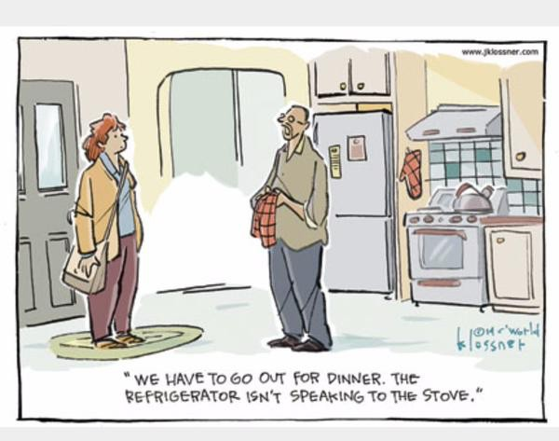
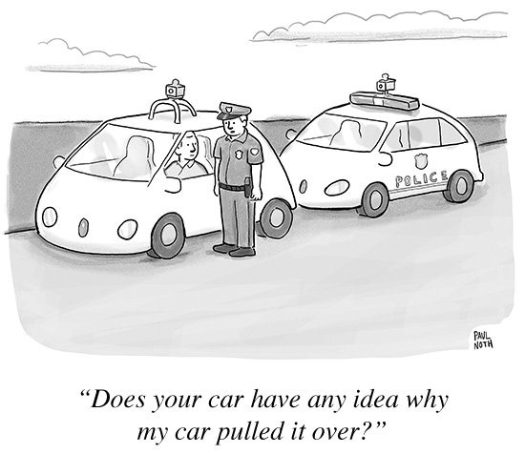
THANK YOU

